Slide 1

Dimensioning
Orthographic Multiview Projections

Slide 2
At the end of this lecture you will be able to:
Use conventional dimensioning techniques to describe size and shape accurately on an engineering drawing.
Place dimension and extension lines correctly.

Slide 3
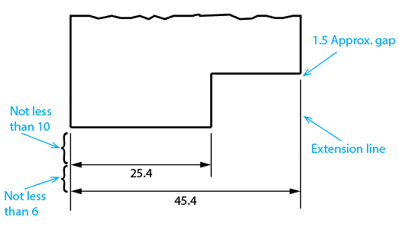
Lines Used in Dimensioning
Some basic definitions:
Dimension line – a thin, light, solid line terminated by arrowheads, indicating the direction and extent of a dimension.
Extension line – a thin, light, solid line that extends from a point on the drawing to which a dimension refers.

Slide 4
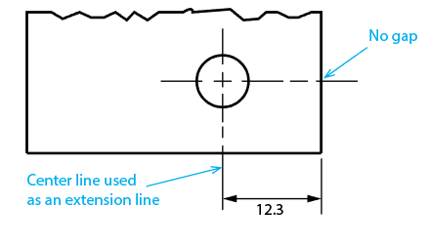
Lines Used in Dimensioning
Center lines can be used as extension lines.

Slide 5
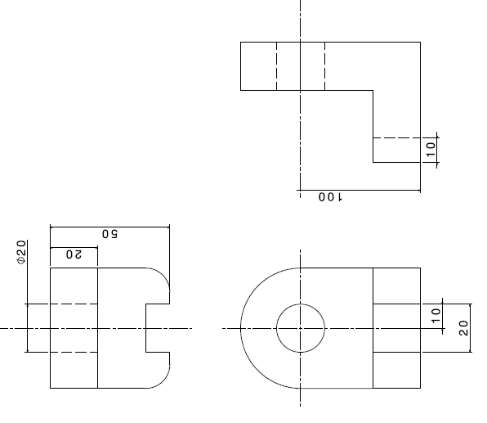
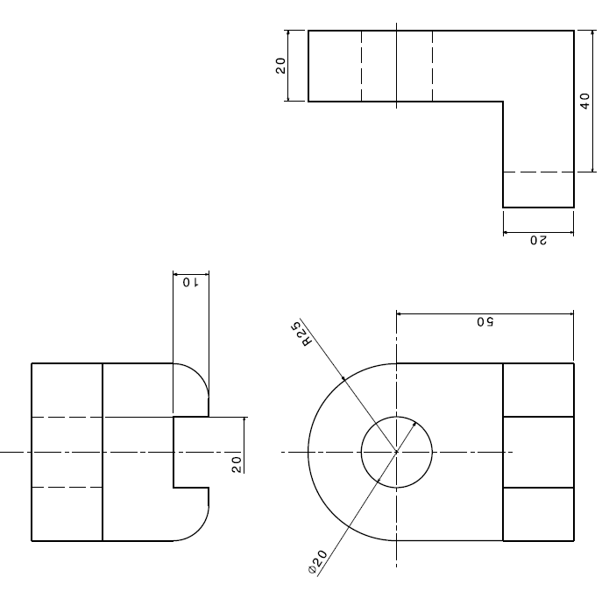
Placing Dimensions
Give dimensions where the contours of the object are defined.
Example 2
In Example 2, dimensions are given with reference to invisible features. So this example is bad.
Example 1
In Example 1, dimensions are given where contours are visible. So this example is good.
Bad
Good

Slide 6
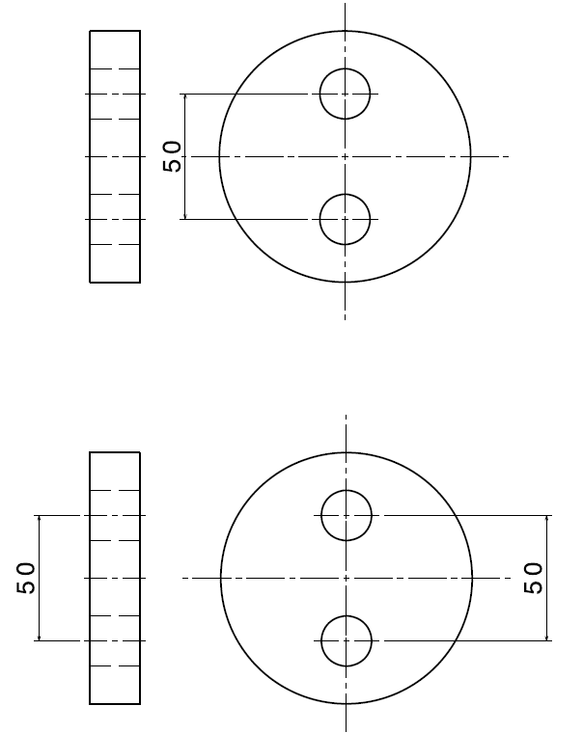
Placing Dimensions
Avoid dimensioning where there are no adjacent views.
Example 1
Example 2
Bad
Good
In Example 2, a dimension is given where there is an adjacent view. So this example is good.
In Example 1, a dimension is given where there is no adjacent view. So this example is bad.

Slide 7
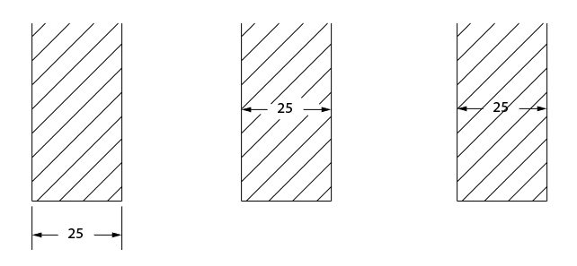
Placing Dimensions
When a dimension must be placed in a hatched area, leave an opening in the hatching or a break in the lines for the dimension value.
A B1 B2
Best
Good
Bad
Drawing A is the best case. If A is not possible because space is tight, it is “Good” to print the dimension as in drawing B1, but it is “Bad” to print the dimension as in drawing B2.

Slide 8
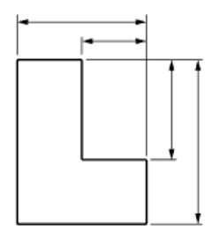
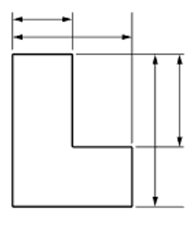
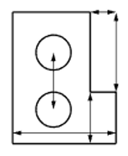
Using Dimension and Extension Lines
Also as illustrated below:
Shorter dimension lines are placed nearest the object outline.
Dimension lines should not cross any other lines.
Avoid crossing extension lines with other extension lines, but it is allowed to do so if space is limited.
A dimension line should never coincide with or extend any line of the drawing.
Bad
Good

Slide 9
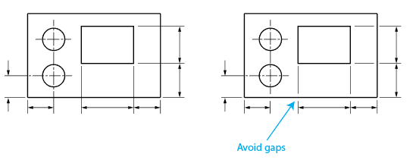
Using Dimension and Extension Lines
When extension lines or center lines cross visible object lines, gaps should not be left in the lines.
Good
Bad

Slide 10
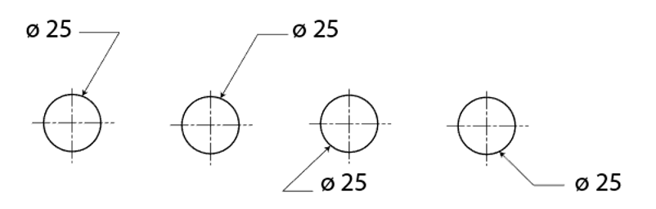
Leaders
A leader is a thin solid line directing attention to a note or dimension. Leaders start with an arrowhead or a dot, and are made up of straight line segments as illustrated below.

Slide 11
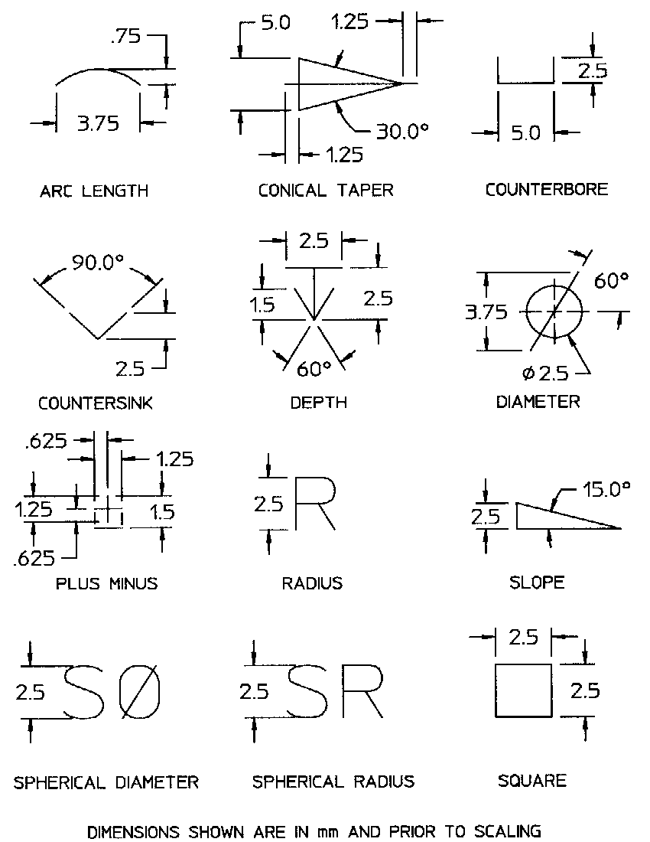
Dimension Symbols
Take a moment to memorize the dimension symbols shown above. These symbols appear frequently in drawings.

